Slide 1
CELL CYCLE AND CELL DIVISION

Slide 2
Learning objectives of the chapter
To learn about the Cell Cycle in general
To learn about the ‘Mitosis and Meiosis’
To study about Significance of mitosis and meiosis
Notes:
In RNA, every nucleotide residue has an additional –OH group present at 2' -position in the ribose.
Also, in RNA the uracil is found at the place of thymine (5-methyl uracil, another chemical name for thymine).

Slide 3
Cell Cycle
Mitosis
(diploid somatic cells)
Meiosis
(haploid cells, and diploid cells of pant)

Slide 4
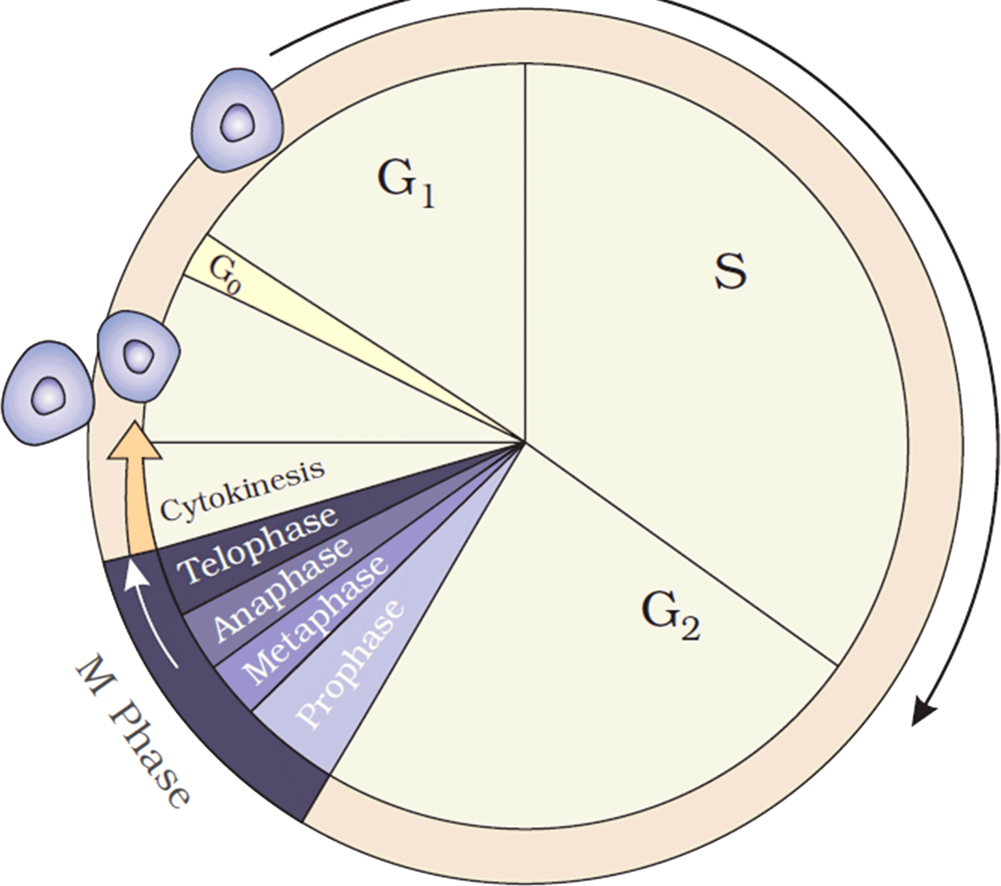
Cell Cycle
Interphase

Slide 5
Cell Cycle
Gap 1 phase: cell is metabolically active & continuously grows
Interphase
PMAT
S or synthesis phase: DNA synthesis
Gap 2 phase: proteins synthesis & growth
Guiescent stage (G0) phase: Cell is metabolically inactive

Slide 6
Mitosis/Equational division
Meiosis/Reductional division
Parent Cell
(2n)
Parent Cell
(2n)
M I
n
n
2n
2n
M II
Daughter Cells
n
n
n
n
Daughter Cells

Slide 7
Significance of mitosis
Mitosis results in production of diploid daughter cells with identical genotype
Growth of multicellular organisms is due to mitosis. Embryo development in animals. Apical and lateral cambium results in continuous growth of plant.
Maintain nucleo-cytoplasmic ratio which is being disturbed due to cell growth
Mitosis contributes to cell repairing. Cells of upper layer of epidermis, lining of the gut, and blood cells are being constantly replaced.

Slide 8
SIGNIFICANCE OF MEIOSIS
Meiosis conserve specific chromosome number of each species across generations
Meiosis increases the genetic variability in the population of organisms from one generation to the next.
Contributes to evolution by inheritance of variation via sexual reproduction.

